Slide 1
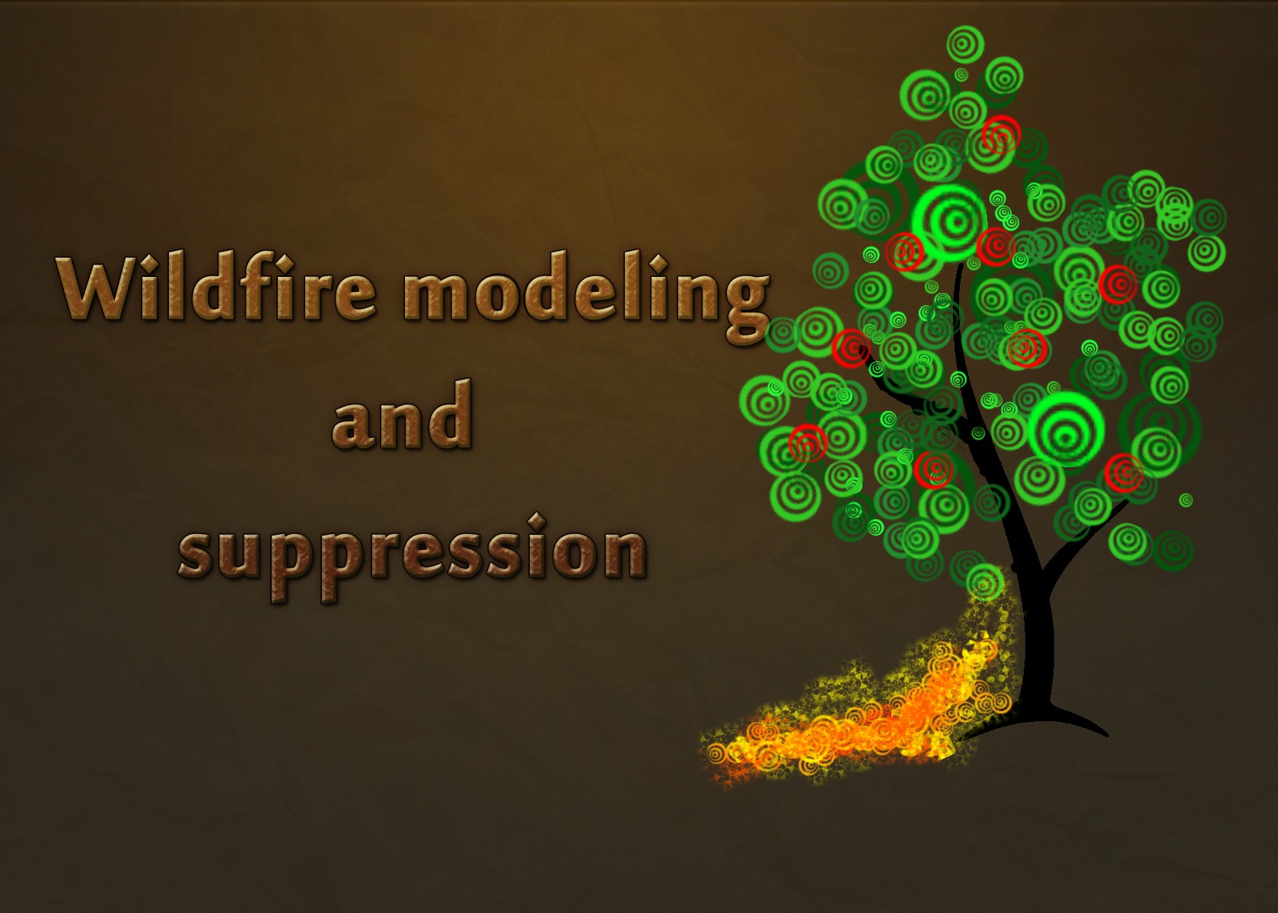

Slide 2
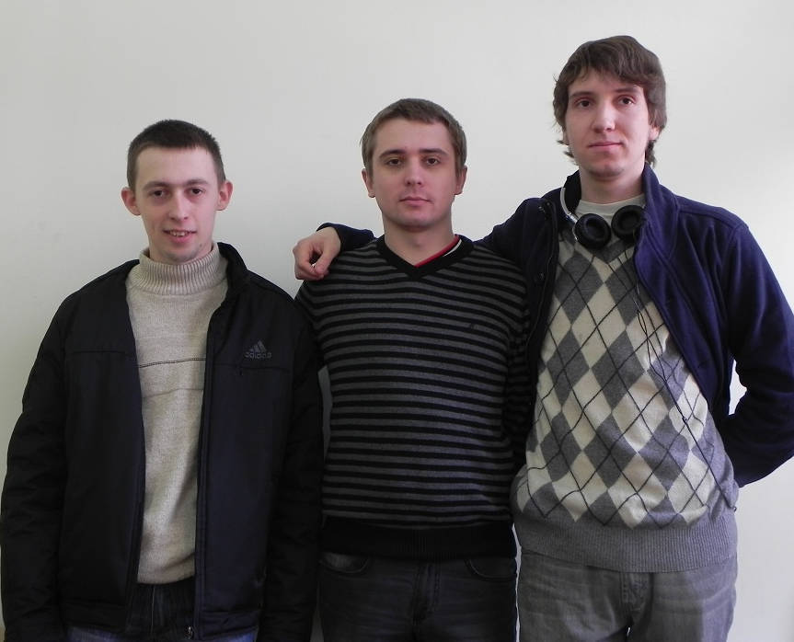
Silver Hawk team
Mentor: Chebanuk Olena Viktorivna
Members:
Andrii Alikieienko
Maksim Shur
Prokopenko Taras
Email: silverhawk.ua.team@gmail.com
Kiev, NAU 2011

Slide 3
Wildfire
Forests damage
Worldwide damage from wildfires is in the billions of euro's annually.
An average of 54,500 square kilometers (13,000,000 acres) burned per year only in US and Canada.
Atmospheric effects
Forest animals damage
Health standards violation

Slide 4
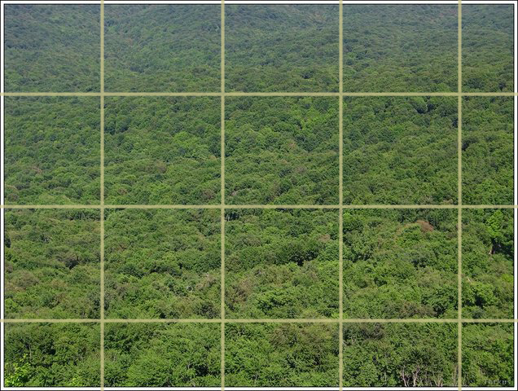
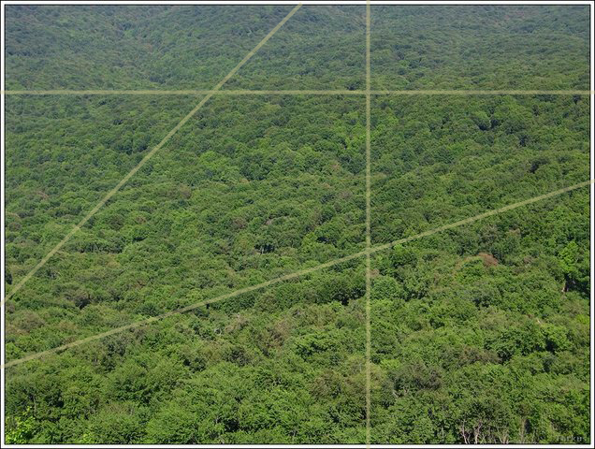
Wildfire prevention
Old firebreak positioning method
New firebreak positioning
method

Slide 5
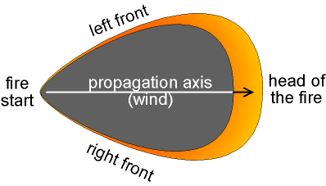
Wildfire suppression
Methods
Modeling for better wildfire suppression

Slide 6
WPAS software concept
Air plane system
Environmental indicators capturing
Photo capturing
Photos +
envi data
Main modeling system
Modeling
Map view
Two main aspects
Map preparation (marking of dangerous spots)
Real time modeling

Slide 7
Map preparation
1
Load image of forest map
2
Set the scale of your map
3
Mark spots with high risk of fire
4
Select the danger level for them
5
Save map file
It can be scan of any forest map, or picture of forest, taken from satellite or plane.

Slide 8
Real time modeling
Detecting fire using photo from Infrared camera with help of OpenCV library.
Auto scaling fire image to place on main map
Modeling wildfire
Giving advices about best suppression wildfire methods

Slide 9
Conclusions
wPaS advantages:
Helps keeping high health standards
Better protection of firemen's life's
Saving more forests trees

